Slide 1
Lists

Slide 2
Lists
Lists store a group of objects (things).
In a list, we can have any type of object.
Unlike strings, lists are mutable.
This means we can change an individual object in a list using index.
We can also add and remove objects from a list.
We can also use lists in a for loop.

Slide 3
Index Review
Indexing is how we access an individual thing inside a group.
We use square brackets([]) after the variable name to denote indexing.
Indexes start at 0 and go to the length of the object minus 1.
You can use indexes to access the individual items in a list, just like with strings.
planets = ['mercury', 'venus', 'earth', 'mars', 'jupiter']
planets[3] is 'mars'

Slide 4
List Indexing
Because lists are mutable, you can use indexes to modify items in a list.
Let's say we have a list of planets, but we misspelled one of them:
planets = ['mercury', 'venus', erath, 'mars']
We can update it using indexing:
planets[2] = 'earth'
Now the value of planets is: ['mercury', 'venus', earth, 'mars']
We just changed one item in the list without changing the entire thing.

Slide 5
Lists in a For Loop
You can iterate through a list in a for loop, just like with a string, because a list is an iterable - a collection of objects.
Iterating through a string goes through each letter:
for i in "hello":
Iteration 1: i = "h"
Iteration 2: i = "e"
Iteration 3: i = "l" etc.
Iterating through a list goes through each item:
for i in [1, 2, 3, 4]:
Iteration 1: i = 1
Iteration 2: i = 2
Iteration 3: i = 3 etc.
Similarly, the len() function returns the number of letters in a string, and the number of items in a list.

Slide 6
Discussion: Why are lists useful?

Slide 7
Exercise
Create a for loop that goes through a list and prints each item in the list, along with its index. (Hint: Create a separate counter variable to keep track of the index.)
Example:
planets = ["mercury", "venus", "earth", "mars"]
0: mercury, 1: venus, 2: earth, 3: mars

Slide 8
Exercise
Write some code that takes one list and creates a second list that has the type for each entry in the list. Hint: Use the type() function and a for loop
Optional:
Make sure you filter out any repeats.

Slide 9
List Methods
append() Adds an element at the end of the list
clear() Removes all the elements from the list
copy() Returns a copy of the list
count() Returns the number of elements with the specified value
extend() Add the elements of a list (or any iterable), to the end of the current list
index() Returns the index of the first element with the specified value
insert() Adds an element at the specified position
pop() Removes the element at the specified position
remove() Removes the first item with the specified value
reverse() Reverses the order of the list
sort() Sorts the list

Slide 10
Adding Elements
append() adds an item to the end of a list:
my_list = ['dog', 'cat']
my_list.append['turtle']
Now, the value of my_list is ['dog', 'cat', 'turtle']

Slide 11
Exercise: List of Pets
You want to make a list containing the types of pets that the user has. Keep prompting the user for a pet until they enter "stop". If it's a new pet, add it to the list. If the list already has that pet, don't add it.

Slide 12
Removing Elements
pop() and remove() both remove an item from a list.
my_list = ['cat', 'dog', 'cat']
pop() removes an item based on its index.
After calling my_list.pop(2), the value of my_list is ['cat', 'dog']
remove() removes an item based on its value. If there are multiple, it removes the first item with that values.
After calling my_list.remove('cat'), the value of my_list is ['dog', 'cat']

Slide 13
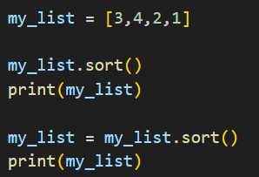
List Methods
Since lists are mutable, the list methods directly modify the list - you don't have to set it equal to anything.
Discussion: What is the output of this code and why?

Slide 14


Sorting Lists
sort() is a list method. You call list.sort(), which directly modifies the list, so you don't have to set it equal to anything.
sorted() is a function. You call sorted(list), which gives you a new, sorted list, so you have to set it equal to something. It doesn't modify the original list.
Correctly sorting a list with sort()
Correctly sorting a list with sorted()

Slide 15
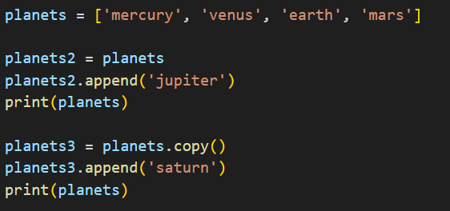
Copying Lists
When you make a copy of a list, it's good practice to use the .copy() method, otherwise modifying the copy will modify the original list.
Discussion: What is the output of this code and why?
After running this code, what is stored at planets, planets2, and planets3?

Slide 16
Example: Removing Values
You have a list of numbers, but it contains multiple of the number 2. Remove the number 2 until it only appears in the list once.

Slide 17
Exercise: Removing All Duplicates
You have a list storing important data for your company, but it contains some duplicate entries. Go through your list and remove all the duplicates. When you're done, each item should appear in the list exactly once.
Hint: How would you expand our previous example, which removed duplicates of one value, to remove duplicates of all values?
Hint 2: You might want to make a copy of the original list to use as reference. You may want to use more than one loop.

Slide 18
Resources
https://www.w3schools.com/python/python_lists.asp
https://docs.python.org/3/tutorial/datastructures.html

